Slide 1


Slide 2
About today…
Brushes
Brush Presets

Slide 3
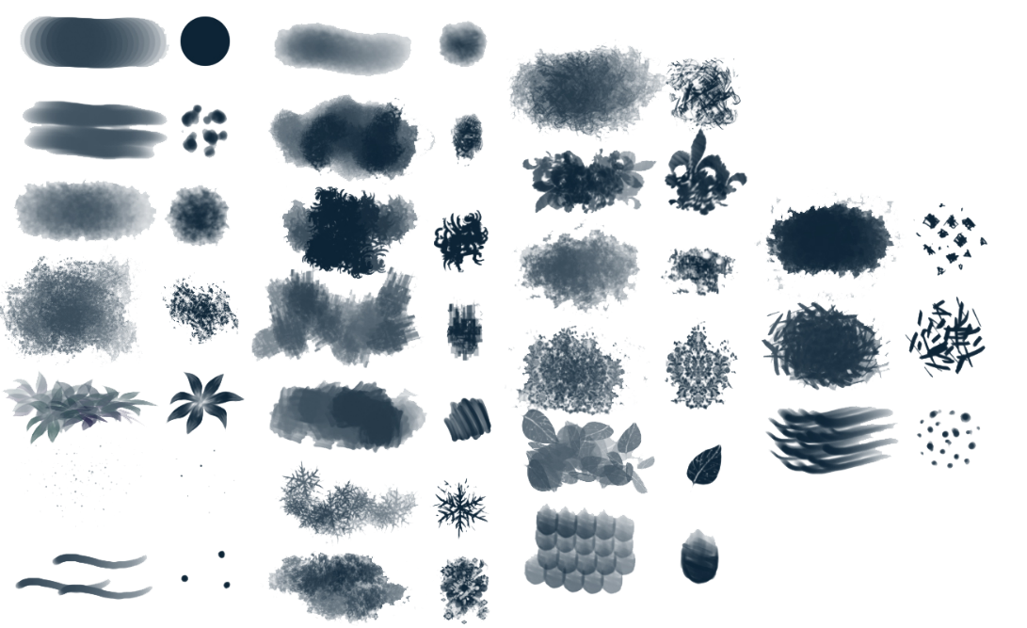
Intro to Brushes in Photoshop
What are Brushes?
Tools used to paint, draw, and create artistic effects
Versatility
Brushes can simulate real-world media like pencils, paint, and ink
Importance of Brush Settings
Adjusting settings allows for creative control over the appearance and behavior of brush strokes
Brush Presets
Predefined brush settings that can be saved and reused for consistency and efficiency

Slide 4
Basic Brush Tool Usage
Selecting the Brush Tool
Located in the toolbar or press "B" on the keyboard
Brush Settings Panel
Access the panel to adjust size, hardness, opacity, and flow
Basic Techniques
Click-and-drag
To create strokes
Click-and-drag
To create individual dots
Practical Application
Drawing, painting, retouching, and adding texture to images

Slide 5
Understanding Brush Dynamics
Size Dynamics
Controls how the brush size changes based on pen pressure, tilt, or mouse movement
Shape Dynamics
Adjusts the shape and angle of the brush tip
Scattering
Disperses brush strokes randomly to create unique textures
Texture
Applies a pattern to the brush stroke, adding depth and detail
Practical Application
Creating more realistic and varied brush effects

Slide 6
Creating Custom Brushes
Define Your Brush Tip
Draw or import an image to use as a brush tip
Select the area and go to Edit > Define Brush Preset
Adjusting Settings
Customize the brush settings to create unique effects.
Saving Custom Brushes
Save your settings as a new brush preset for future use
Practical Application
Tailoring brushes to suit specific project needs, such as custom textures or effects

Slide 7
Working with Brush Presets
Accessing Brush Presets
Found in the Brush Settings panel or by right-clicking on the canvas
Preset Categories
General Brushes
Basic brushes for painting and drawing
Dry Media Brushes
Save your settings as a new brush preset for future use
Wet Media Brushes
Save your settings as a new brush preset for future use
Special Effects Brushes
Save your settings as a new brush preset for future use
Loading and Saving Presets
Load brushes from files or save your own presets for consistency

Slide 8
Importing and Exporting Brushes
Importing Brushes
Download brush files (.abr format) from online sources
Go to Edit > Presets > Preset Manager, click "Load," and select the brush file
Exporting Brushes
Save custom brushes by selecting them in the Preset Manager and clicking "Save Set."
Share brushes with others or keep them for future projects
Practical Application
Expanding your brush library with third-party brushes or sharing your custom brushes with collaborators

Slide 9
Advanced Brush Settings
Dual Brushes
Combines two brushes to create complex patterns and textures
Color Dynamics
Varies the color of the brush stroke based on settings such as foreground/background jitter
Brush Pose
Adjusts the angle, tilt, and pressure of the brush stroke for precise control
Practical Application
Achieving complex, dynamic effects for artistic projects or detailed retouching

Slide 10
Using Brushes in Different Modes
Blend Modes
Change how the brush stroke interacts with the layers below it (e.g., Multiply, Overlay, Screen)
Pressure Sensitivity
Varies the stroke's opacity and size based on the pressure applied (useful with graphic tablets)
Opacity vs. Flow
Opacity
Controls the transparency of the stroke
Flow
Controls how quickly paint is applied, affecting the buildup of the stroke
Practical Application
Achieving subtle shading, highlights, or blending effects

Slide 11
Practical Applications of Brushes
Digital Painting
Creating artwork from scratch with different brushes to simulate traditional media
Retouching
Using brushes for dodging, burning, and spot healing to refine photos
Texturing
Adding textures to images or designs to create depth and interest
Special Effects
Creating effects like smoke, light streaks, or particles using brushes

Slide 12
Common Mistakes and Tips
Common Mistakes
Overusing one brush or setting, leading to repetitive and unnatural results
Ignoring pressure sensitivity, resulting in uniform strokes
Forgetting to save custom brushes, losing valuable presets
Tips for Effective Brush Use
Regularly experiment with new brushes and settings
Use pressure sensitivity for natural and dynamic strokes
Save and organize your custom brushes for easy access

Slide 13
Practical Exercise
Task
Create a digital painting or textured design using a variety of brush tools and presets
Instructions
Select a base image or start with a blank canvas
Experiment with different brushes, adjusting settings to achieve desired effects
Incorporate custom brushes or presets to enhance your work
Save your favorite brushes as presets for future use

